Slide 1
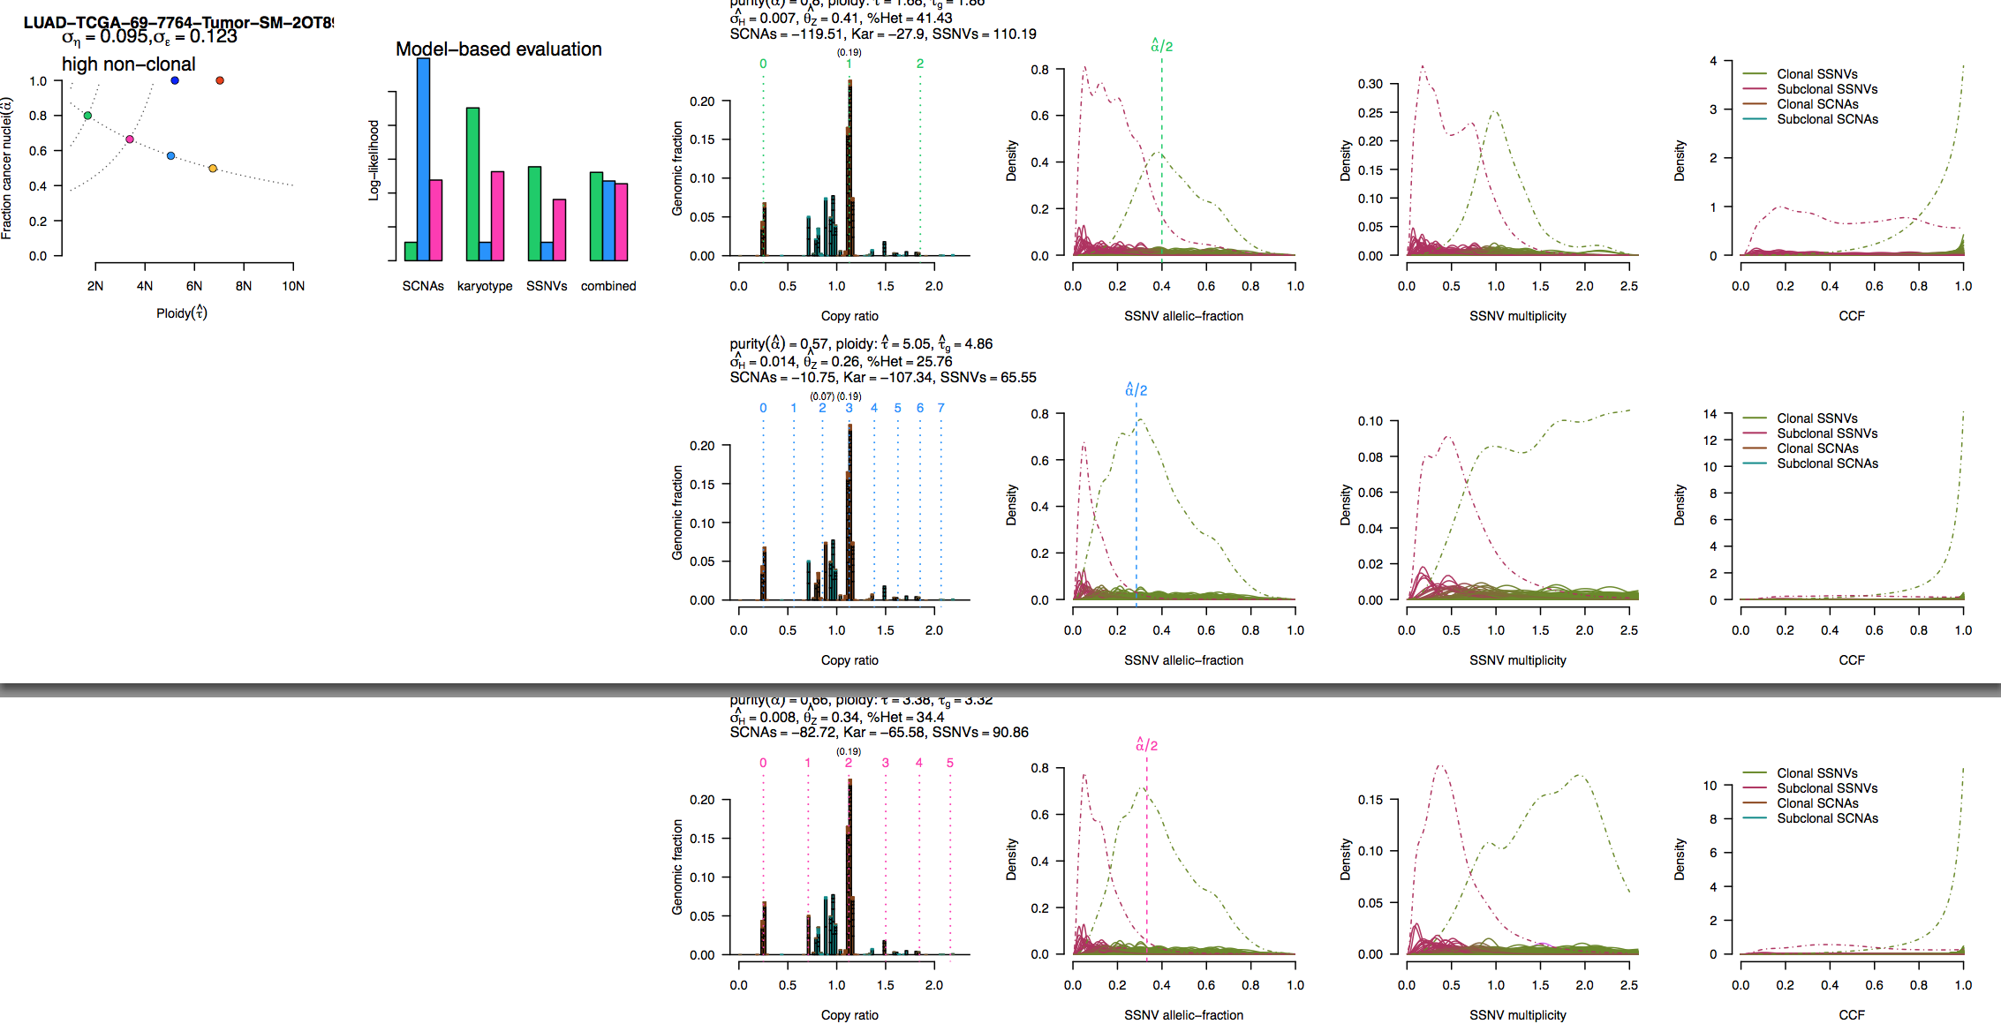
Challenging sample due to subclonal SCNAs –
Prefer 1st solution

Slide 2
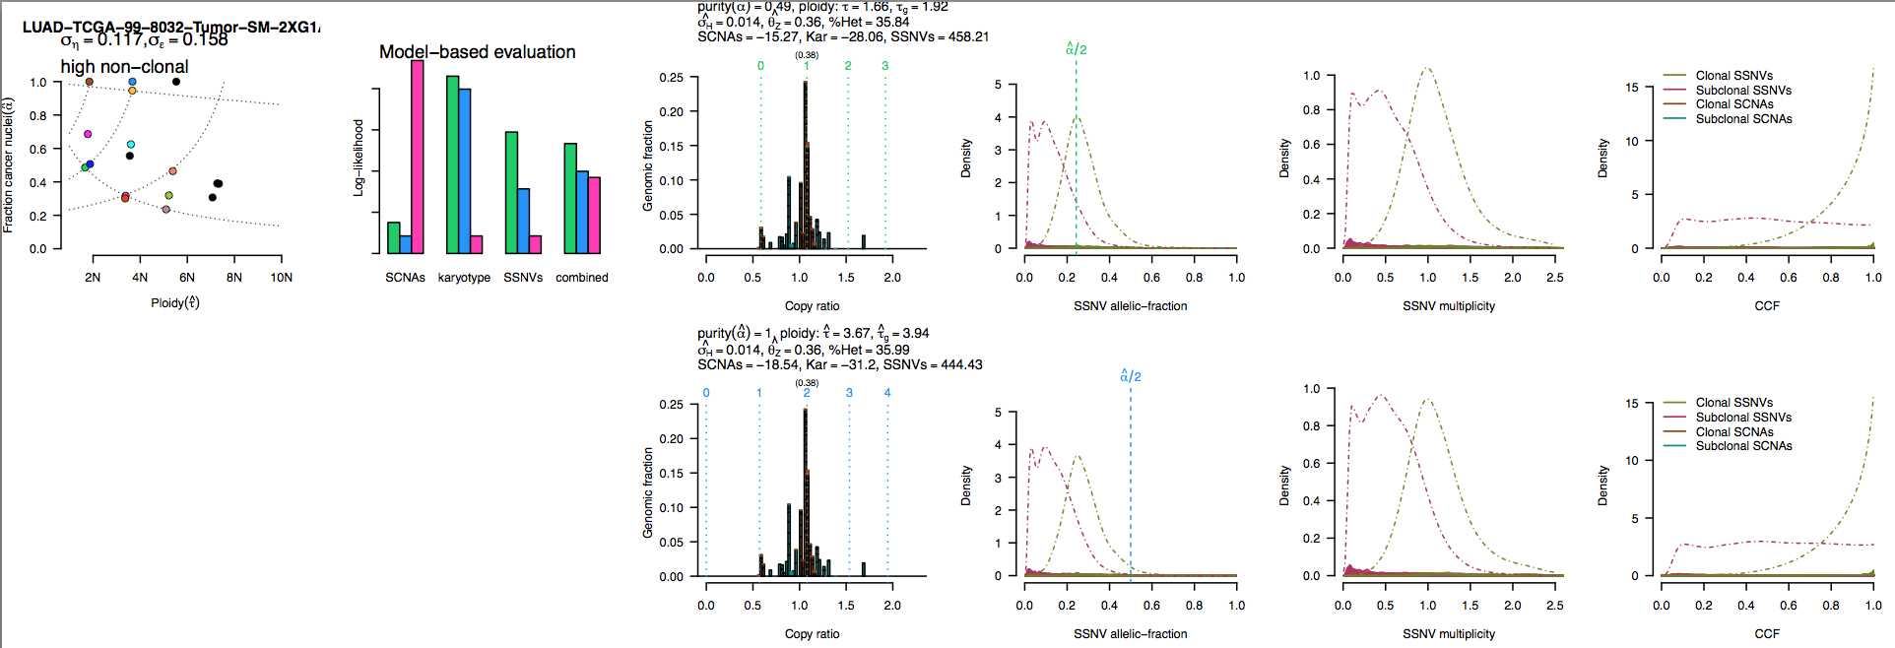
Extensive subclonal SCNAs – but 1st solution looks correct.

Slide 3
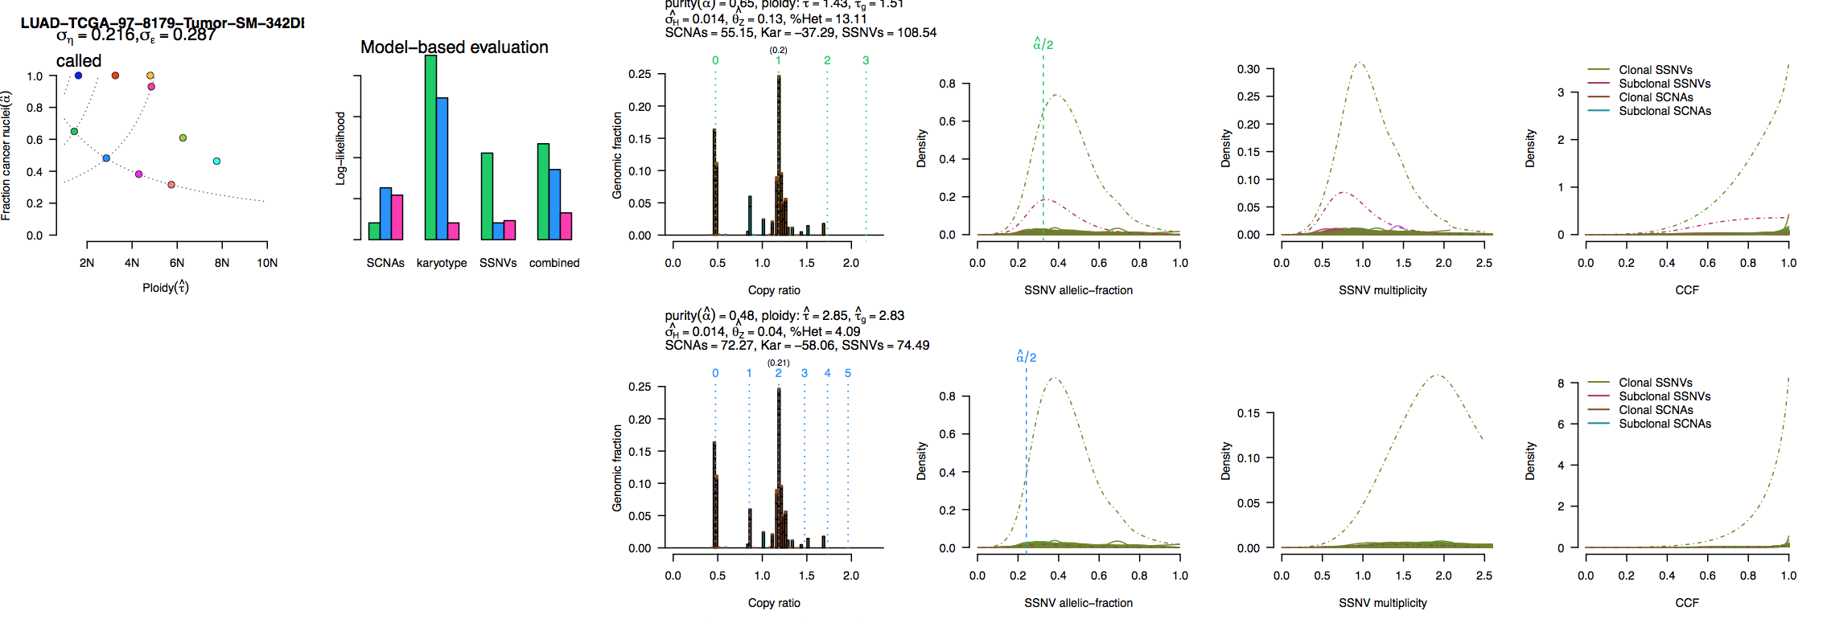
Possible genome doubling? Unlikely, because of SSNV data – no or few SSNVs at multiplicity=1 in doubled solution (below) – this would imply that no SSNVs occurred between doubling and sampling (unlikely)
Prefer 1st solution

Slide 4
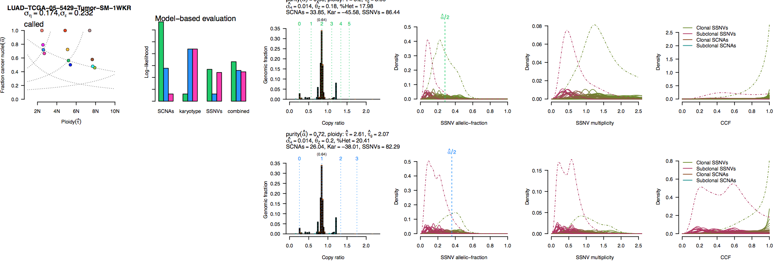
Prefer 2nd solution – genome doubling does not help explain the SCNAs.
Also – 1st solution SSNV multiplicity peak at 1.4 – bad fit.

Slide 5
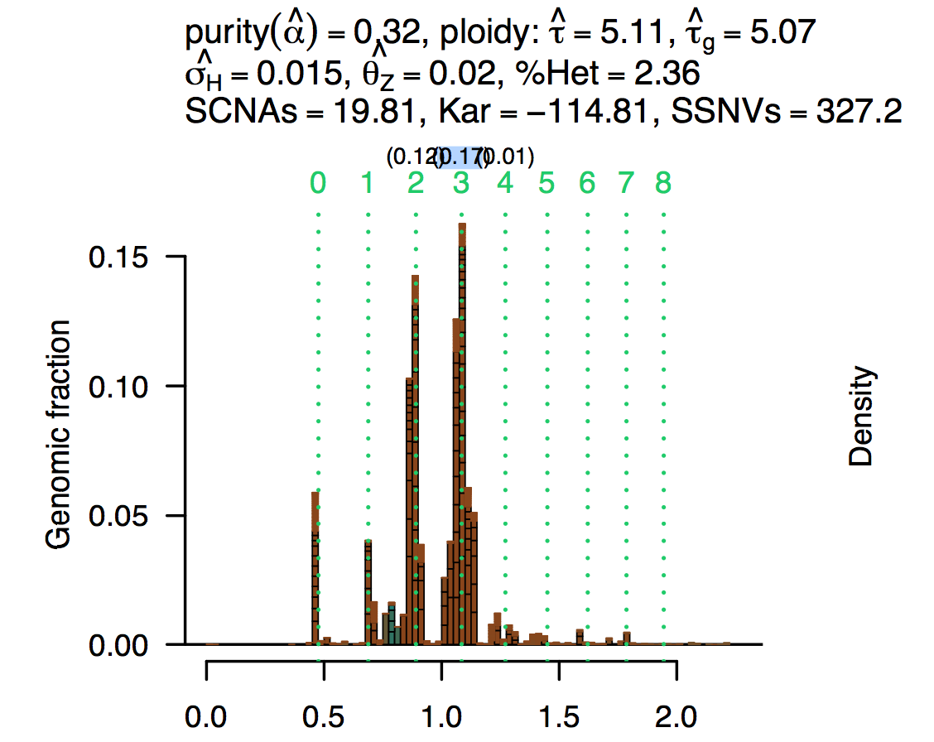
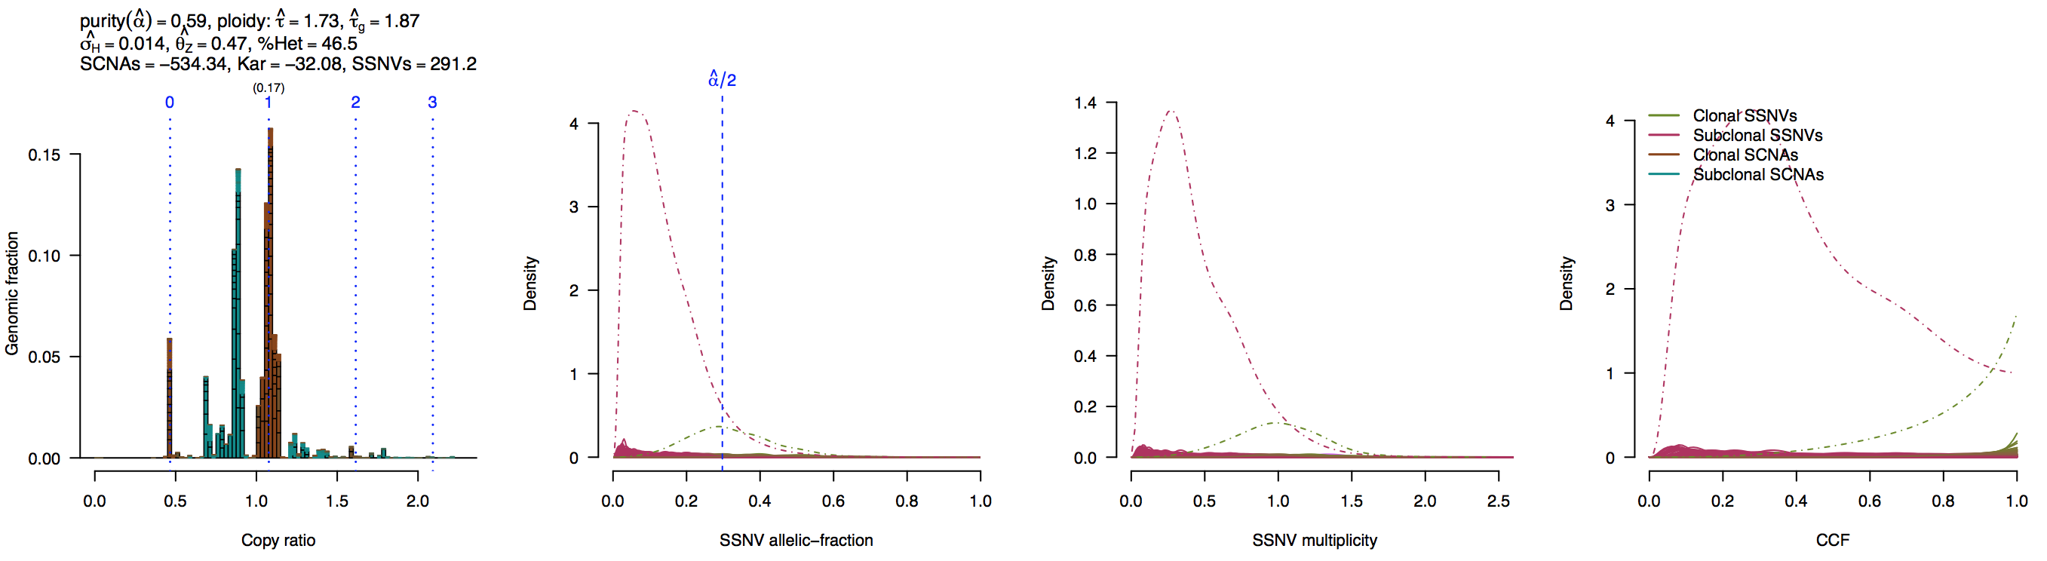
A challenging sample due to a small # of subclonal populations having extensive SNCAs – tendency to over-fit with high-ploidy solution.
Notice that solution #1 has allelic balance of 0.17 at CN=3 – this is very unlikely to be real (only expect balance at powers of 2).
Prefer much simpler solution #6 (below)

Slide 6
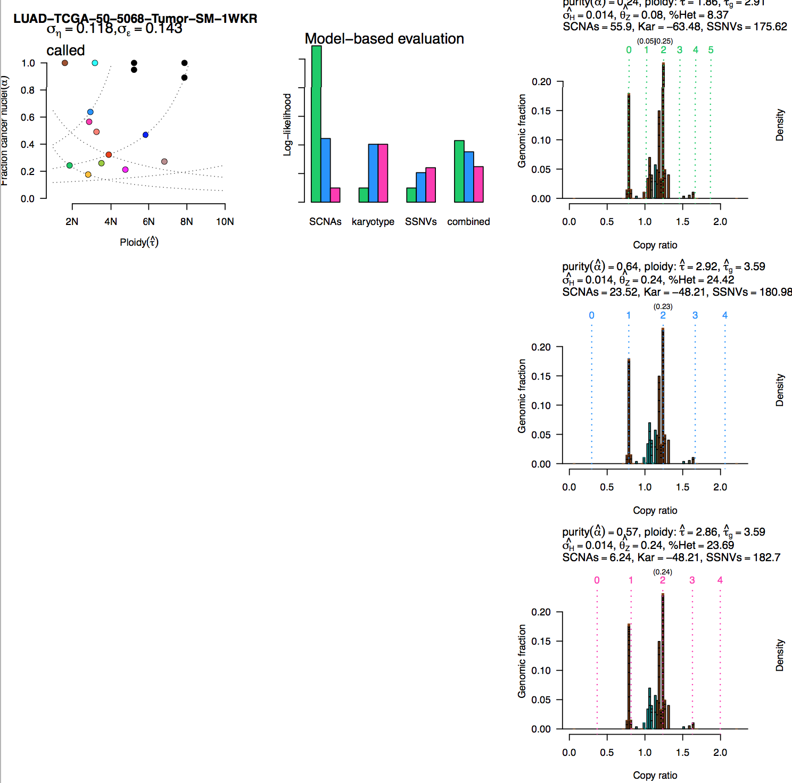
OOPS – ABSOLUTE did not find the correct mode – this happens rarely – will be fixed in future releases – for now leave these uncalled.

Slide 7
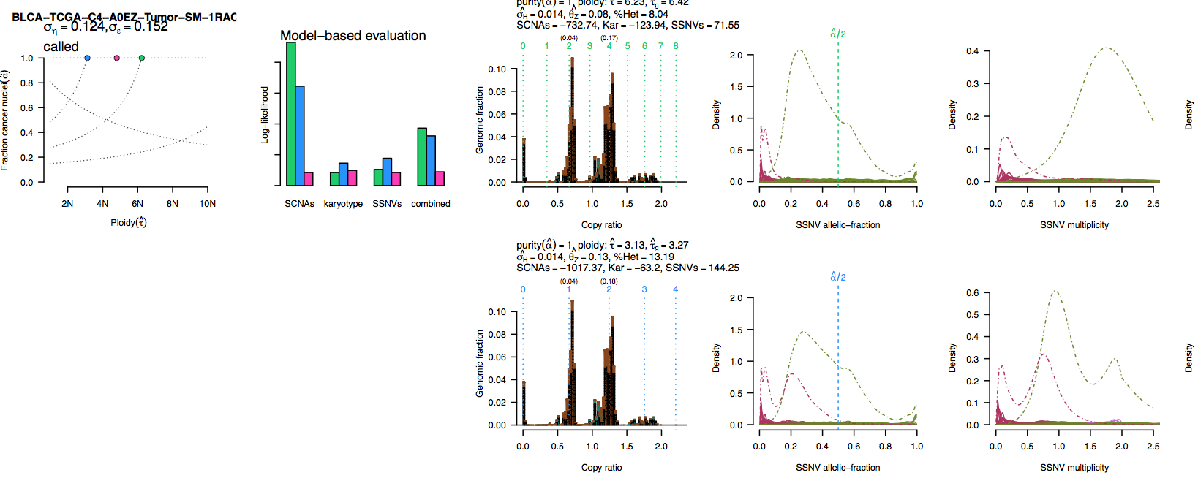
Challenging sample – likely a ‘bad’ SNP hybridization
Prefer 2nd solution – lower complexity. Also – excellent multiplicity peaks.

Slide 8
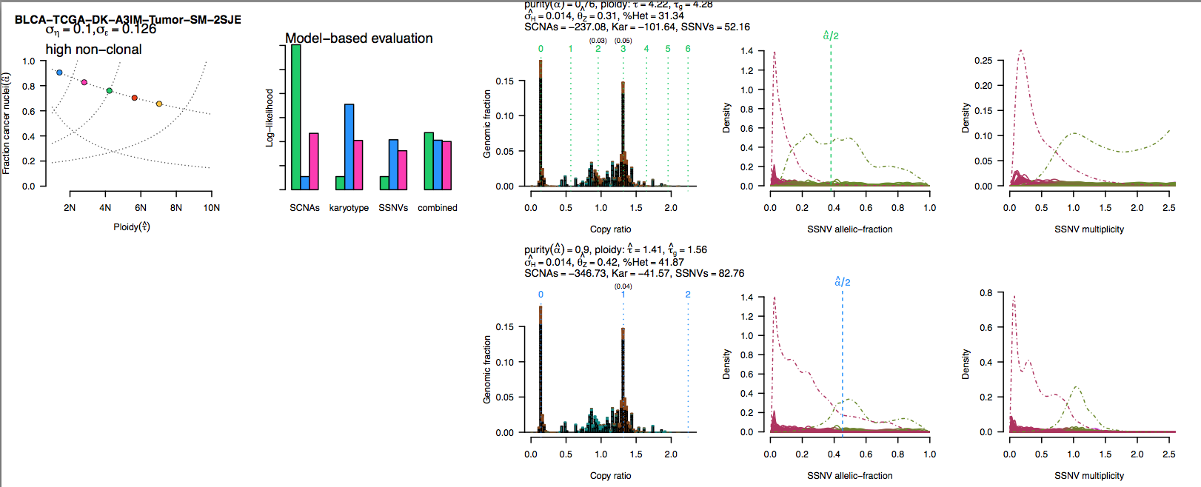
A challenging sample – extensive apparent subclonal SCNAs / SSNVs
Prefer 2nd solution (low ploidy) – due to lower complexity

Slide 9
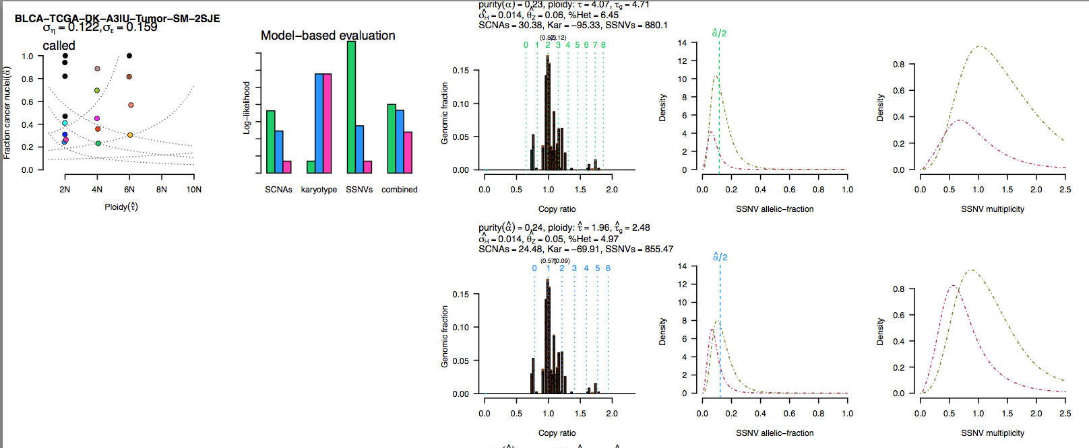
A challenging sample: low purity + subclones
Prefer 2nd solution due to LOH peak

Slide 10
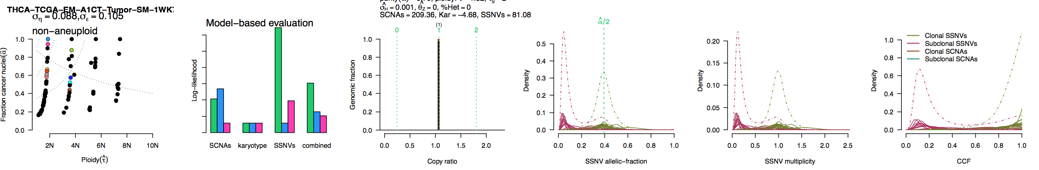
Calling with no SCNAs: SSNVs only
You need to override the ‘non-aneuploid’ status in the calls file (change to ‘1’ in this case). This will be fixed in future version (when SSNVs are present).

Slide 11
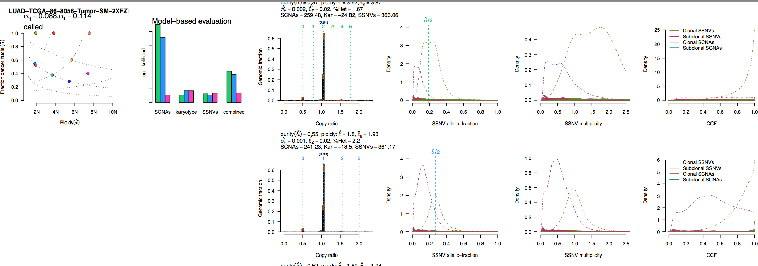
A strange call by ABSOLUTE (oops) – no apparent reason to prefer 1st solution – override to 2nd simpler solution.
Hopefully fixed in future version.

Slide 12
Some unusual Karyotypes –
Near haploid genomes (a,b). Uncommon, but found in lung adeno, GBM, stomach cancer, and assorted other cancers.
Hyperploid (>6n) (c)

Slide 13
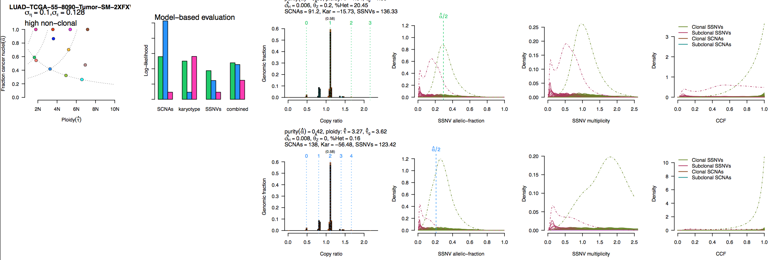
Genome doubling or not? Tough call – even with SSNVs.

